Slide 1
Detecting Malicious URLs using DNNs
Kira Chan
Department of Computer Science and Engineering
Michigan State University, East Lansing, Michigan
CSE891 Cyber Physical System Security
Dr. Qiben Yan

Slide 2
Introduction
Uniform Resource Locators (URLs) are commonly used to access web service
However, malicious actors may put malicious content or files on these websites
When unsuspecting users visits these website, they can potentially compromise sensitive private information or install malware
In this work, we propose a Convolutional Neural Network approach to classify URLs

Slide 3
Background: URL
A URL essentially acts as a text address for a webserver’s IP address
IP addresses are hard to memorise, website names are not
However, malicious actor can trick users with similar domain names
E.g., paypal.com vs paypa1.com or paypal-accounts.com
Components of a URL [1]

Slide 4
Categories of malicious URLs
URLs are classified into four different categories in this work
Benign – Regular, innocent websites
Defacement – Benign website that have had their contents maliciously defaced
Phishing – Malicious website that mimics legitimate websites to deceive users into compromising sensitive information
Malware – Websites that contain malicious files. The malware is installed on the user’s device when they visit the link

Slide 5
Key contributions of our work
A DNN that can be applied when a user enters a URL to check if the URL is likely to be malicious or not
If the website is malicious, redirect the user into a warning page first

Slide 6
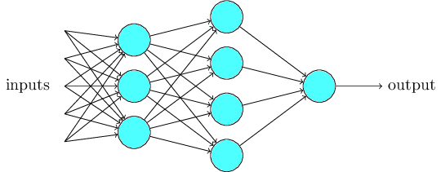
Deep Neural Networks
DNNs are artificial neural networks that consist of
An input layer
Multiple layers of hidden units (hence the term deep)
An output layer
Unlike traditional machine learning, DNNs can learn abstract/complex features and patterns directly from training data
Example illustration of a DNN [2]

Slide 7
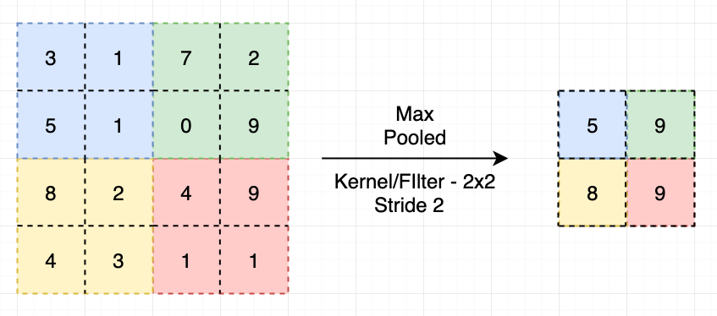
Convolutional layers
Convolutional neural networks are capable of capturing spatial and temporal relationships in the input
They are typically used to condense high dimensional data into smaller dimensions without losing information
Example of a Convolutional Layer [3]

Slide 8
Natural Language Processing
Neural Networks work with numbers (e.g., pixels in an image can be represented by numeric value)
Text must first be converted into numbers
Several approaches in literature
Vectorisation/transformer
Each word is mapped to a number
Character-level encoding
Each character is mapped to a number (e.g., ASCII representation)

Slide 9
Related work
A number of research efforts have previously addressed malicious URL detection using machine learning
Comprehensive survey
SVM
Decision Tree
Logistic Regression
Naïve Bayes
LSTM or GRU
Our work addresses applying CNN to the problem of malicious URL classification

Slide 10
Dataset
We use a dataset obtained from Kaggle [4]
Malicious URLs Dataset – Manu Siddhartha
Consist of 651,191 URLs
Separated into four categories: Benign, Defacement, Phishing, Malware
The dataset is curated from five different sources
Format in .csv
Column 1: URL
Column 2: Label

Slide 11
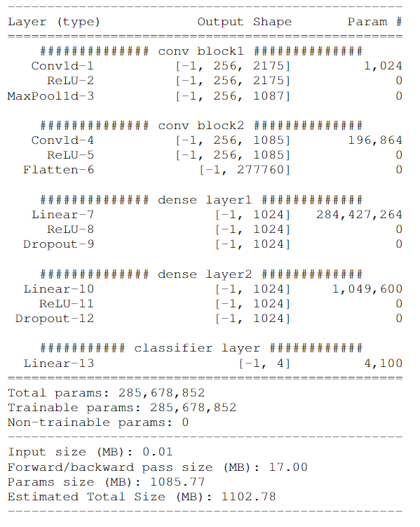
Model Architecture
We created a custom CNN for the task
The Architecture consist of:
Conv Layers
Max Pooling
ReLU Activation Layers
Linear Dense Layers
Dropout
Classifier Layer

Slide 12
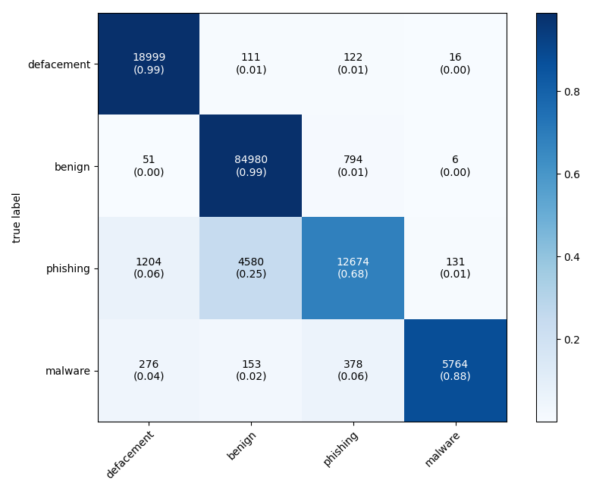
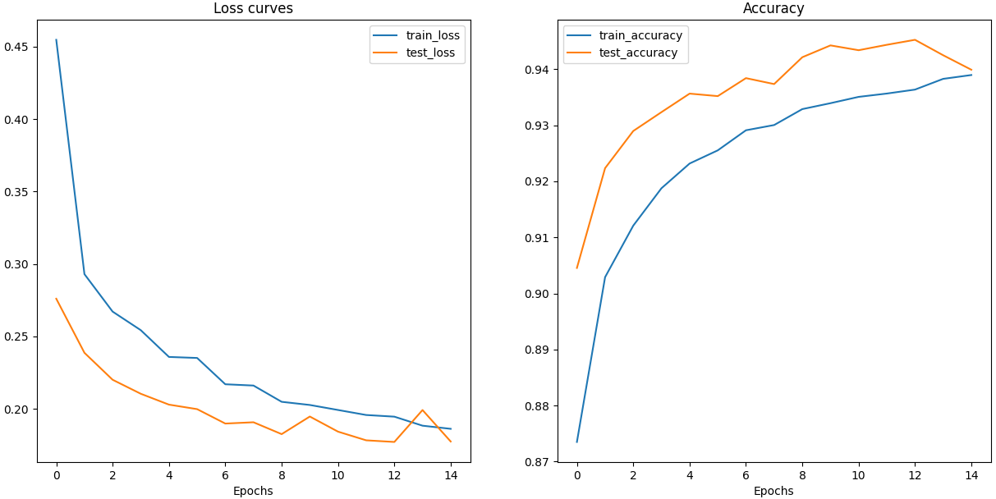
Model Results
The model has an accuracy of 94% on both the training and dataset

Slide 13
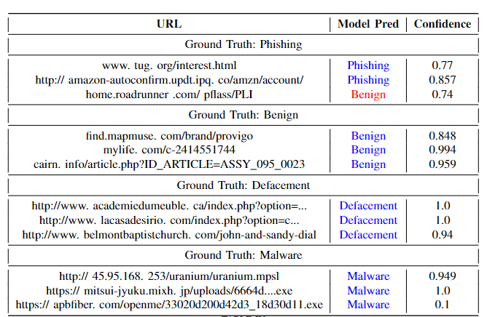
Demo

Slide 14
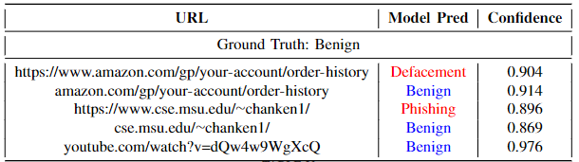
Real-world applicability?
We want to test if the trained model can be applied to practical use
I tested the model against several sample URLs

Slide 15
Issues
The model trained does exactly what it is trained to do, predict URLs in the distribution given
However, the dataset use is not well constructed
Garbage in, garbage out
URLs in the dataset are not uniformly formatted
Overfit on artificial features of the model, rather than correct ``features’’

Slide 16
Conclusion and Future Work
In summary, we have proposed and implemented a custom CNN for malicious URL detection
The model performs extremely well for the dataset given
However, it fails to generalise into data it has not seen before
This is likely caused by a ``reality gap’’ between the dataset and the real-world application
Future work:
Clean up the dataset more first, ensure all the URLs are formatted in the same manner (either include or remove all protocol and www.)
LSTM, RNN, etc.
In the dataset, there is an uneven distribution of labels (mostly benign), thus Focal loss can be used to mitigate the unbalanced class issue

Slide 17
References
[1] Mozilla Web Docs, “What is a url?.” https://developer.mozilla.org/ en-US/docs/Learn/Common questions/What is a URL, Date Unknown.
[2] M. A. Nielsen, Neural networks and deep learning, vol. 25. Determination press San Francisco, CA, USA, 2015.
[3] K. Rana, “Pooling layer — short and simple.” https://ai.plainenglish.io/ pooling-layer-beginner-to-intermediate-fa0dbdce80eb, April 2020
[4] M. Siddhartha, “Malicious urls dataset.” https://www.kaggle.com/ datasets/sid321axn/malicious-urls-dataset, January 2021.

